Slide 1
IST 3420: Introduction to Data Science and Management
6. Data Exploration

Slide 2
Reading Assignment
Hypothesis Testing
https://courses.edx.org/c4x/UTAustinX/UT.7.01x/asset/Chapter_12.pdf
How to Correctly Interpret P Values
http://blog.minitab.com/blog/adventures-in-statistics/how-to-correctly-interpret-p-values

Slide 3
Learning Objectives
Understand methods (list wise deletion, and imputation) used to deal with missing data
Be able to detect outliers in a dataset by using multiple methods such as boxplot rule, z-score, and density-based local outlier
Understand the difference between covariance and correlation
Be able to distinguish between correlation and causation
Be able to visualize correlation relationships (scatter plot, scatter plot matrix, correlation matrix)
Understand the distinction between population and sample and the concept of hypothesis testing
Understand the meaning of p-value and be able to interpret p-value correctly
Be able to conduct one-sample t-test and two-sample t-test

Slide 4
Agenda
Missing Data
Outliers
Correlation Analysis
Hypothesis Testing

Slide 5
Missing Data

Slide 6

Missing Data and Why It Exists
“The best thing to do with missing values is not to have any”, but this is almost never the case.
Missing values occur for plenty of reasons: machines that fail, individuals who forget or do not want to answer some questions of a questionnaire, etc.
They are problematic since most statistical methods cannot be applied on an incomplete dataset or they can potentially lead a model astray
Image source: etsy.com

Slide 7
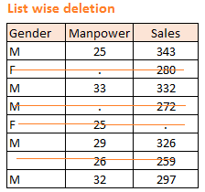
Handle Missing Data
A missing value is indicated as NA (not available). Arithmetic calculation on missing values yields missing values.
Two Basic Methods:
List wise deletion: remove missing values or cases from analysis.
Imputation: replace missing data with substituted values (mean or median of quantitative attribute or mode of qualitative attribute)
Common R functions:
is.na(): Identify which elements are missing
na.omit(): Remove missing values or cases (list wise deletion)

Slide 8
Missing Data Gotchya’s
NaN: stands for Not a Number and represents an undefined or unrepresentable value. e.g. square root of -1
NULL: empty value but not missing data.
Inf: infinite value but not missing data, e.g. 10/0
is_na(NaN)
[1] TRUE
is_na(NULL)
[1] logical(0)
is_na(Inf)
[1] FALSE

Slide 9
Summary of Missing Values Handling
List wise deletion
Applies when the amount of missing data is relatively small
Use parameter na.rm = TURE in function calls to exclude missing value from data analysis
Use na.omit() function to remove missing values from dataset
Simple imputation: replace by mean
Applies when leaving out available data points deprives the data of some amount of information
Usually introduces bias
Sample Syntax:
x[is.na(x)] <- mean(x, na.rm=TRUE)
x <- dplyr::recode(x, .missing = mean(x,na.rm = TRUE))
Other advanced imputation methods
MICE, Amelia, missForest, Hmisc, mi, etc.

Slide 10
R Code: Dealing with Missing Values
## Missing Values ##
x <- c(1,2,3,4,NA)
# Determine which elements are missing
is.na(x)
# Count missing values
table(is.na(x))
# Remove missing values
na.omit(x)
# Arithmetic calculation on missing values yield missing values.
min(x)
max(x)
mean(x)
var(x)
# Exclude missing values from analysis
min(x, na.rm = TRUE)
max(x, na.rm = TRUE)
mean(x, na.rm = TRUE)
var(x, na.rm = TRUE)
# Simply Imputation: Replace by Mean
x
x[is.na(x)] <- mean(x, na.rm=TRUE)
X
## Handling missing values in data frames
library(dplyr)
# Create a group variable
g <- c(rep("group_1",5),rep("group_2",5))
# Generate two random variables
a <- rnorm(10, mean = 0, sd = 1)
b <- a*0.5 + rnorm(10,mean = 0, sd = 1)
a[4] <- NA
b[7] <- NA
dat <- data.frame(g,a,b)
dat
cor(a,b)
cor(a,b, use = "pairwise.complete.obs")
dat %>% group_by(g) %>% summarise(mean(a),mean(b))
dat %>% group_by(g) %>% summarise(mean(a, na.rm = TRUE),mean(b, na.rm = TRUE))
dat %>% na.omit() %>% group_by(g) %>% summarise(mean(a),mean(b))

Slide 11
Outliers

Slide 12

Why Outliers Matter?
Outlier detection (also known as anomaly detection) is the process of finding data objects with behaviors that are very different from expectation.
Outlier detection is important in many applications, such as:
Intrusions in communication networks
Fraud in financial data
Fake news and misinformation
Healthcare analysis
Industry damage detection
Security and surveillance
etc.
https://towardsdatascience.com/density-based-algorithm-for-outlier-detection-8f278d2f7983

Slide 13
Outliers
Outliers are unusually small or large values in a dataset.
Outliers have a huge impact on the results of data analyses.
Common ways of dealing with outliers
Recode: when outliers are incorrectly recorded in the dataset
Remove: when outliers are incorrectly included in the dataset
Keep: when outliers are correct values in the dataset

Slide 14
Detecting Potential Outliers
Basic methods
Graphical approach: boxplot rule
Statistical approach: z-Score
Density-based approach: local outlier factor
Different methods may lead to different results.

Slide 15
Boxplot Rule
Values beyond [Q1 – 1.5 * IQR, Q3 + 1.5 * IQR] are outliers.
outliers
upper limit or max value (smaller one)
whiskers
IQR
median
lower limit or min value (larger one)

Slide 16
R Code: Detecting Outliers According to Boxplot Rule
# Generate 100 values
set.seed(1)
x <- rnorm(100)
# Intentionally add 3 outliers
x <- c(x,-3.5, 3.3, 4.1)
# Create boxplot
out <- boxplot(x)
out
# Show the structure
str(out)
# Print outliers
out$out

Slide 17
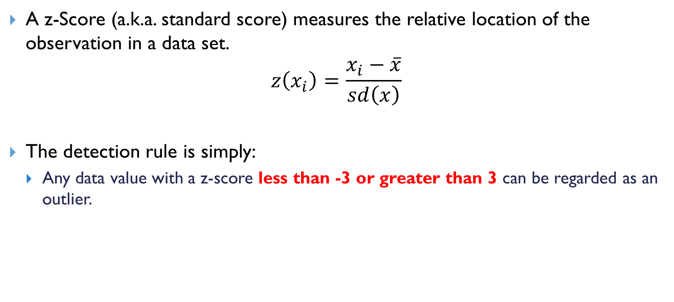
z-Score Method
A z-Score (a.k.a. standard score) measures the relative location of the observation in a data set.
$$z\left(x_{i}\right)=\frac{x_{i}−\overline{x}}{sd\left(x\right)}$$
The detection rule is simply:
Any data value with a z-score less than -3 or greater than 3 can be regarded as an outlier.

Slide 18
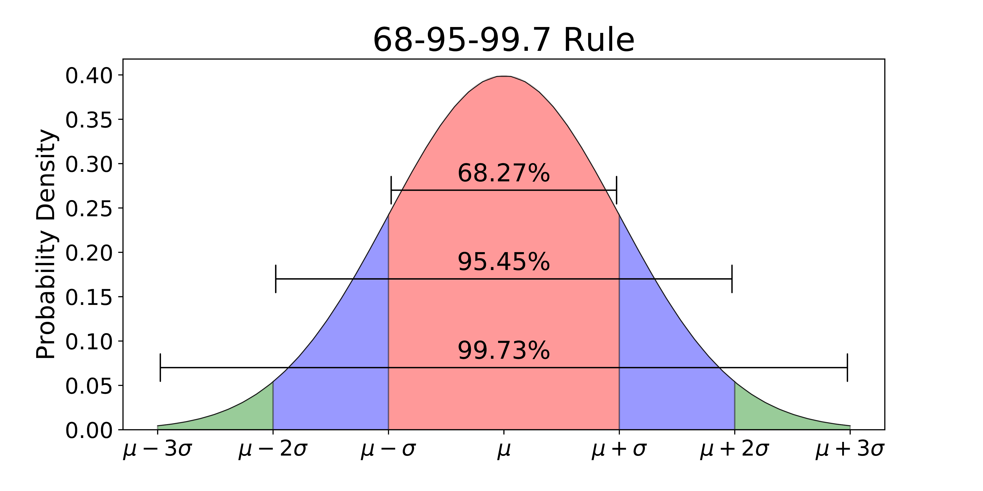
z-Score Method: 68-95-99.7 Rule
An empirical rule tells us:
For data with a bell-shaped distribution, almost all values will be within three standard deviations of the mean.
https://towardsdatascience.com/understanding-the-68-95-99-7-rule-for-a-normal-distribution-b7b7cbf760c2

Slide 19
R Code: Detecting Outliers Using z-Scores
# Generate 100 random values
set.seed(1)
x <- rnorm(100)
# Intentionally add 3 potential outliers
x <- c(x,-3.5, 3.3, 4.1)
# Calculate z-score
z <- (x - mean(x))/sd(x)
# Print outliers
x[which(z > 3 | z < -3)]
# Note: In the 2nd condition, make sure to have a space between "<" and "-".
# Or else R may interpret "<-" as assignment rather than comparison.
Only -3.5 and 4.1 are detected as potential outliers. Why?
Notes:
Answer: Because the 3 large values added into x changed the mean and sd of x.

Slide 20
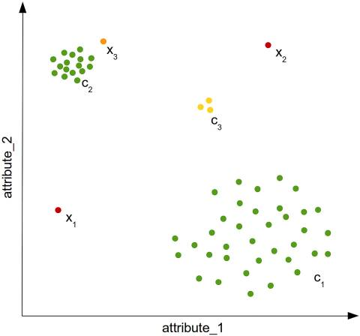
Density-based local outlier detection
LOF (Local Outlier Factor) Algorithm
The local density of a value is compared with that of its neighbors.
If the value’s density is significantly lower than that of its neighbors (with an LOF value greater than one), the value is in a sparser region than its neighbors.
This suggests that the value is an outlier.
Unfortunately, it is still not clear in LOF, above which score threshold we can clearly think about an anomaly.
For the detail, refer to http://www.rdatamining.com/examples/outlier-detection
& https://www.ncbi.nlm.nih.gov/pmc/articles/PMC4836738/

Slide 21
R Code: Detecting Outliers Using LOF Algorithm
# Detecting outliers using LOF algorithm
library(dprep)
dat <- iris[-5]
# Calculate local outlier factor score for each observation. # Partition all observations into k = 5 clusters.
dat$lof <- lofactor(data = dat, k = 5)
dat
# Plot the density of the LOF scores
plot(density(dat$lof))
# Pick top 5 as outliers
outliers <- head(dat[order(dat$lof, decreasing=T),],5)
# Print outliers
print(outliers)

Slide 22

How to deal with outliers?
If the outliers detected turn out to be wrong data, we certainly need to correct the data or exclude the outliers from data analysis.
If the outliers are valid data (for example, income of Bill Gates), we may keep it in our data analysis but with caution of how such outliers could interfere with our data analysis.

Slide 23
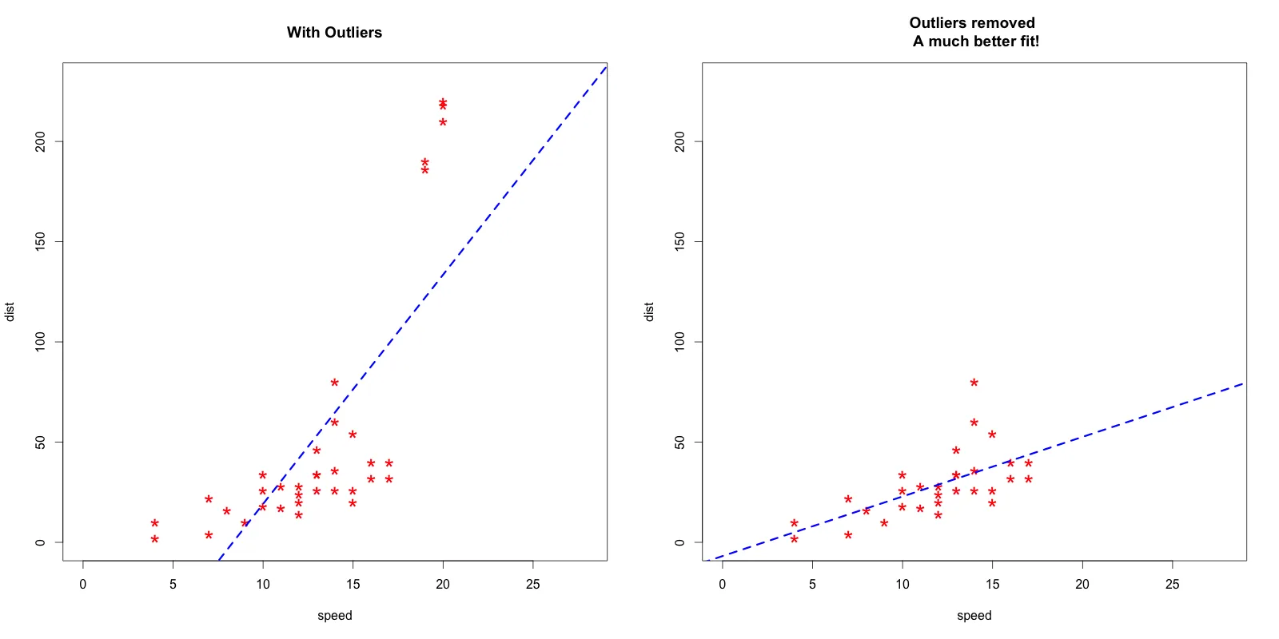
To drop or not to drop?
Source: https://www.r-bloggers.com/outlier-detection-and-treatment-with-r/

Slide 24
Use %in% to filter out outliers
Syntax: x %in% y
%in% returns a logical vector indicating if there is a match or not for its left operand
> 1:4 %in% 1:2
[1] TRUE TRUE FALSE FALSE
> !1:4 %in% 1:2
[1] FALSE FALSE TRUE TRUE
Remove outliers from dataset
dat2 <- dplyr::filter(dat,!dat$lof %in% outliers$lof)

Slide 25
Correlation Analysis

Slide 26
Recap: Scatter Plot Matrix
A way to roughly show the relationship between multiple variables
pairs(~mpg+disp+hp+wt, data=mtcars, main="A Scatterplot Matrix")
plot(mtcars[c("mpg","disp","hp","wt")], main="A Scatterplot Matrix")

Slide 27
Motivation
We can use various tabular and graphical tools to explore the relationship between variables. For example, cross table, scatter plot, and scatterplot matrix.
Although such tabular and graphical tools vividly show the relationship, they have some limitations:
It’s difficult to compare multiple relationships. For example, is the negative relationship between mpg and wt stronger than the one between mpg and hp?
It’s inefficient when there are many variables.
Can we numerically measure the relationship between variables?

Slide 28
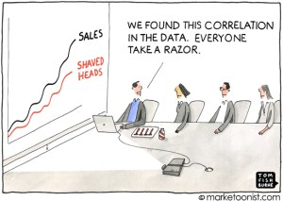
Correlation Analysis
Two ways of measuring linear association between two variables
Covariance
Direction of the linear association
Correlation
Direction of the linear association
Strength of the linear association

Slide 29
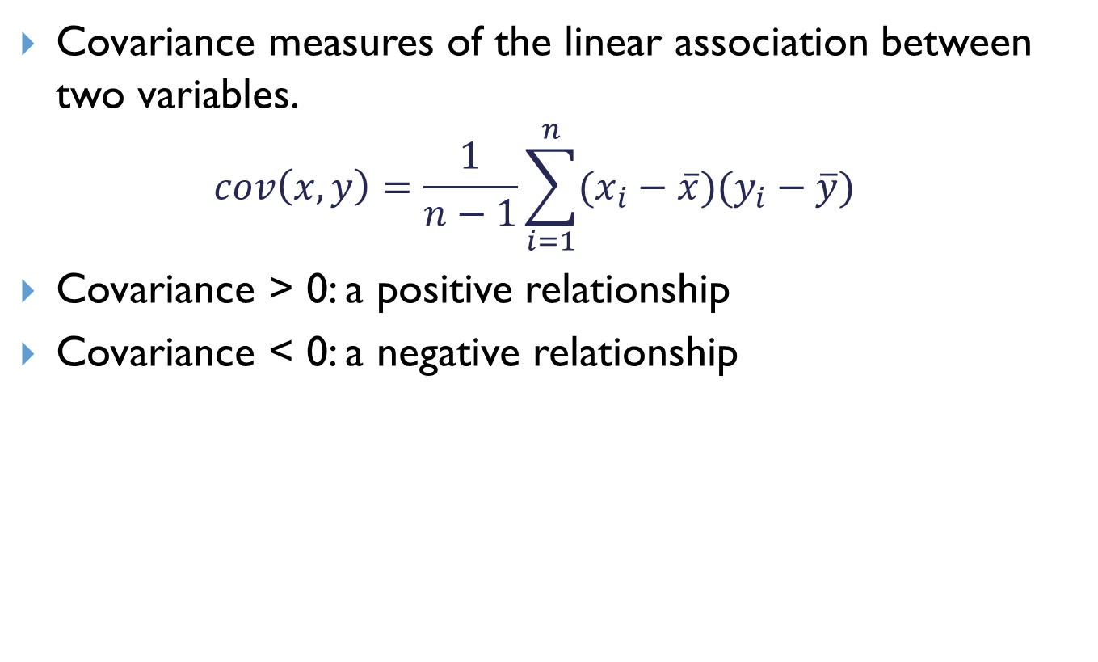
Covariance
Covariance measures of the linear association between two variables.
$$cov\left(x,y\right)=\frac{1}{n−1}\sum_{i=1}^{n}{(x_{i}−\overline{x})(y_{i}−\overline{y})}$$
Covariance > 0: a positive relationship
Covariance < 0: a negative relationship

Slide 30
R Code: Covariance
# Define a function to calculate covariance
mycov <- function(x,y){
n <- length(x)
x_hat <- mean(x)
y_hat <- mean(y)
sum((x-x_hat)*(y-y_hat))/(n-1)
}
cat("covariance =", mycov(mtcars$mpg,mtcars$wt))
cat("covariance =", mycov(mtcars$hp,mtcars$wt))
# Use cov() function to calculate variance
cov(mtcars$mpg,mtcars$wt)
cov(mtcars$hp,mtcars$wt)
cov(mtcars$mpg,mtcars$wt)) = -5.116685
cov(mtcars$hp,mtcars$wt)) = 44.19266
Interpretation: The covariance of mpg and wt is -5.116685, which indicates a negative linear relationship between the two variables.

Slide 31
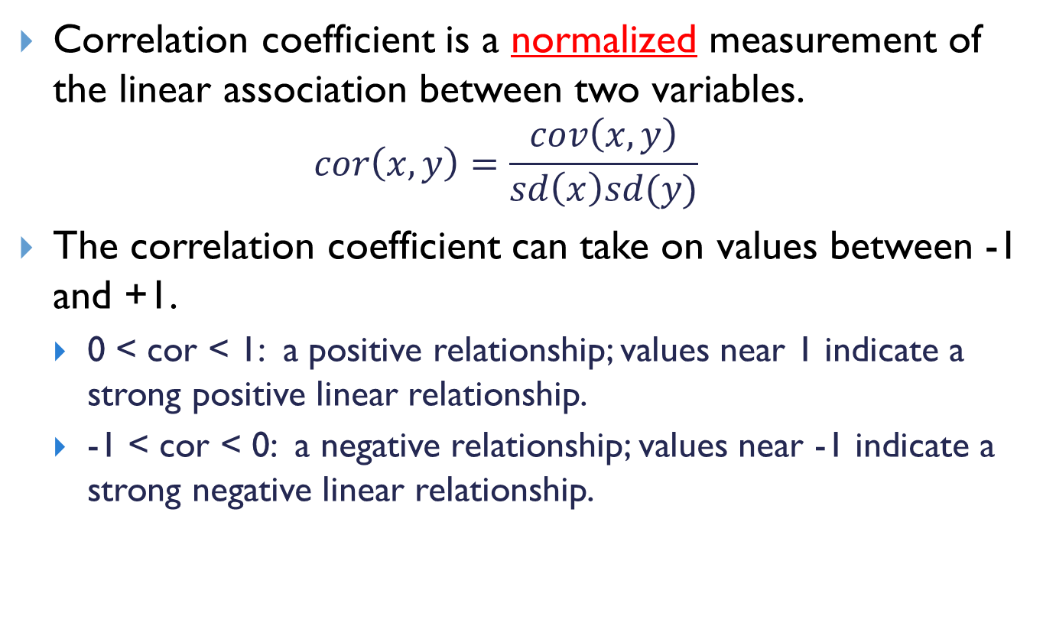
Correlation Coefficient
Correlation coefficient is a normalized measurement of the linear association between two variables.
$$cor\left(x,y\right)=\frac{cov\left(x,y\right)}{sd\left(x\right)sd(y)}$$
The correlation coefficient can take on values between -1 and +1.
0 < cor < 1: a positive relationship; values near 1 indicate a strong positive linear relationship.
-1 < cor < 0: a negative relationship; values near -1 indicate a strong negative linear relationship.

Slide 32
Interpreting Correlation Coefficient
Correlation coefficient measures the direction and strength of the linear association between two variables
Direction
Increasing (positive)
Decreasing (negative)
Strength
How closely are X and Y related?

Slide 33
R Code: Correlation
# Manually calculate correlation coefficient
cov(mtcars$mpg,mtcars$wt)/(sd(mtcars$mpg)*sd(mtcars$wt))
# Use cor() function to calculate correlation coefficient
cor(mtcars$mpg,mtcars$wt)
cor(mtcars$hp,mtcars$wt)
cor(mtcars$mpg,mtcars$wt)) = -0.8676594
cor(mtcars$hp,mtcars$wt)) = 0.6587479
Interpretation:
The correlation coefficient of mpg and wt is -0.8676594, which indicates a strong negative linear relationship between the two variables.
The correlation coefficient of hp and wt is 0.6587479, which indicates a moderate positive linear relationship between the two variables.

Slide 34
Visualization of Correlation Matrix
# install.packages("corrplot")
library(corrplot)
corrplot(cor(mtcars), method="number", tl.cex=1)

Slide 35
(cont.)
corrplot(cor(mtcars), method="ellipse", tl.cex = 1)

Slide 36
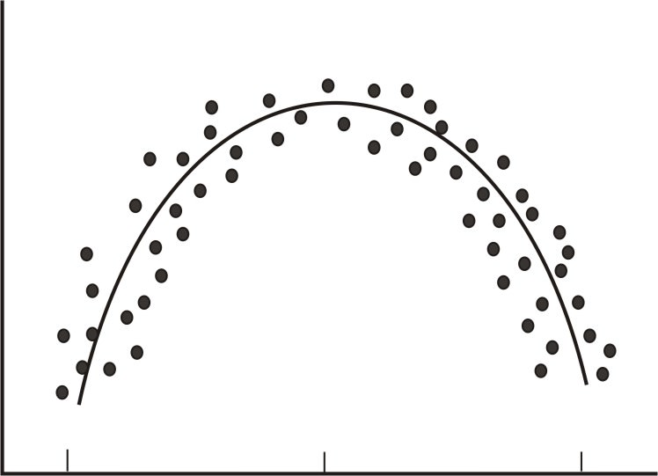
Common errors of correlation - linearity
Correlation coefficient is the measure of the linear relationship between two variables. However, while many pairs of variables have a linear relationship, some do not.
We call these non-linear relationships curvilinear relationships.
If we graphed performance against anxiety, we would see that anxiety has a strong affect on performance. However, if we calculated the correlation coefficient, we would arrive at a figure around zero.
Therefore, the correlation coefficient is not always the best statistic to use to understand the relationship between variables.
https://www.ck12.org/statistics/scatter-plots-and-linear-correlation/lesson/Scatter-Plots-and-Linear-Correlation-ADV-PST/

Slide 37
Note: Correctly Interpret Covariance and Correlation
Covariance and correlation can only measure linear relationship.
A zero covariance or correlation does NOT mean that the two variables have no relationship.
a <- seq(from = -5, to = 5, by = 0.1)
b <- a^2
plot(a,b)
# Add regression line
abline(lm(b~a),col = "red")
cov(a,b)
cor(a,b)
Note: a and b has a functional relationship (a = b²). However, their covariance and correlation are very small (<0.0001). In statistics, we usually call such relationship as a non-linear relationship.

Slide 38
Common errors of correlation – homogeneity of the group
When a group is homogeneous, or possesses similar characteristics, the range of scores on either or both of the variables is restricted.
For example, suppose we are interested in finding out the correlation between IQ and salary.
If only members of the Mensa Club (a club for people with IQs over 140) are sampled, we will most likely find a very low correlation between IQ and salary, since most members will have a consistently high IQ, but their salaries will still vary.
This does not mean that there is not a relationship-it simply means that the restriction of the sample limited the magnitude of the correlation coefficient.
https://www.ck12.org/statistics/scatter-plots-and-linear-correlation/lesson/Scatter-Plots-and-Linear-Correlation-ADV-PST/

Slide 39
Common errors of correlation – sample size
One may assume that the number of observations used in the calculation of the correlation coefficient may influence the magnitude of the coefficient itself.
However, this is not the case.
While the sample size does not affect the correlation coefficient, it may affect the accuracy of the relationship.
The larger the sample, the more accurate of a predictor the correlation coefficient will be of the relationship between the two variables.
https://www.ck12.org/statistics/scatter-plots-and-linear-correlation/lesson/Scatter-Plots-and-Linear-Correlation-ADV-PST/

Slide 40

Common errors of correlation: Correlation = Causality?
Correlation is a measure of the linear relationship between two variables-it does not necessarily state that one variable is caused by another.
Image source: https://openparachute.wordpress.com/2015/11/15/anti-fluoride-hypothyroidism-paper-slammed-yet-again/correlation/

Slide 41
Correlation Does Not Mean Causality
Reverse Causality
A
B
A
B
A causes B
B causes A
When a country's debt rises above 90% of GDP, growth slows.
Therefore, high debt causes slow growth.
In actuality, low growth causes debt to increase.

Slide 42
Correlation Does Not Mean Causality (cont.)
Third Factor C Causes both A and B
C
A
B
As ice cream sales increase, the rate of drowning deaths increases sharply.
Therefore, ice cream consumption causes drowning ???
Ice cream is sold during the hot summer months at a much greater rate than during colder times, and it is during these hot summer months that people are more likely to engage in activities involving water, such as swimming.
The increased drowning deaths are simply caused by more exposure to water-based activities, not ice cream.

Slide 43
Hypothesis Testing

Slide 44
Descriptive vs. Inferential Statistics
Descriptive: e.g., Median; describes data you have but can't be generalized beyond that
We’ve talked about Exploratory Data Analysis (EDA), such as 5-number summary, boxplots, histogram, scatterplot matrix, correlation anlysis
Inferential: e.g., t-test, that enable inferences about the population beyond our data
These are the techniques we’ll leverage for Machine Learning and Prediction

Slide 45
Examples of Business Questions
Simple (descriptive) Stats
“Who are the most profitable customers?”
Hypothesis Testing
“Is there a difference in value to the company of these customers?”
Segmentation/Classification
“What are the common characteristics of these customers?”
Prediction
“Will this new customer become a profitable customer? If so, how profitable?”
adapted from Provost and Fawcett, “Data Science for Business”

Slide 46
Population vs. Sample
Population: the whole body of subjects that are of interest to us in a particular study.
Sample: a portion of the population from which we collect data.
In most cases, the dataset set we have in hand does not cover all subjects. However, we still want to know the patterns or relationships for the whole subject.
In order to make statements on population based on data collected from sample, the sample must be representative of the population. This involves hypothesis testing.
For example, if we want to study college students in U.S.A:
population = all college students in U.S.A.
a sample = 1000 students randomly selected at MST

Slide 47
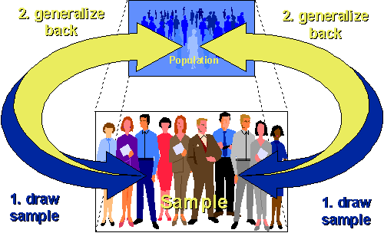
Sampling Model
Identify the population and then draw a fair sample from that population and do statistical analysis;
Because the sample is representative of the population, you can automatically generalize your results back to the population.
Source: http://www.socialresearchmethods.net/kb/external.php
Notes:
Source: http://www.socialresearchmethods.net/kb/external.php

Slide 48
Hypothesis Testing
A hypothesis is a statement about a population parameter.
The goal of a hypothesis test is to decide, based on a sample from the population, which of two complementary hypotheses is true.
Null hypothesis H₀: a tentative assumption about a population parameter
Alternative hypothesis H_{a}: the opposite of the null hypothesis
A null hypothesis is what, the researcher tries to disprove/reject whereas an alternative hypothesis is what the researcher wants to prove.

Slide 49
Forms for Null and Alternative Hypotheses about a Population Mean
µ is the population mean
µ₀ is a hypothesized value of the population mean
One-tailed
(lower-tail)
One-tailed
(upper-tail)
Two-tailed
The null and alternative hypotheses divide all possibilities into two non-overlapping sets.
The equality part is always in null hypotheses.

Slide 50
In-Class Exercise
The school principal wants to test if it is true what teachers say – that high school juniors use the computer an average 3.2 hours a day.
What are our null and alternative hypotheses?
If we want to test if the average daily computer use is at least 3.2 hours, what are the null and alternative hypotheses?
Notes:
https://courses.edx.org/c4x/UTAustinX/UT.7.01x/asset/Chapter_12.pdf
Page 249
U0 = 3.2, ua <> 3.2
U0 <= 3.2, ua > 3.2

Slide 51
What is p-value?
P value is the probability of obtaining the observed or more extreme effect in your sample data, assuming that the null hypothesis is true.
The smaller the p-value, the stronger the evidence against the null hypothesis.
Commonly used threshold for p-value
P > 0.10 | No evidence against the null hypothesis. The data appear to be consistent with the null hypothesis.
0.05 < P < 0.10 | Weak evidence against the null hypothesis in favor of the alternative.
0.01 < P < 0.05 | Moderate evidence against the null hypothesis in favor of the alternative.
0.001 < P < 0.01 | Strong evidence against the null hypothesis in favor of the alternative.
P < 0.001 | Very strong evidence against the null hypothesis in favor of the alternative.
Source: What is a p-value? http://www.stat.ualberta.ca/~hooper/teaching/misc/Pvalue.pdf

Slide 52
One and Two Sample Tests
Purpose | Type of Data
 | Gaussian | Non-Gaussian | Binomial
Compare one group to a hypothetical value | One sample t-test | Wilcoxon Test | Binomial Test
Compare two paired groups | Paired t-test (student's t-test) | Wilcoxon Test | McNemar’s Test
Compare two unpaired groups | Two sample t-test | Wilcoxon-Mann-Whitney Test | Chi-Square or Fisher’s Exact Test
Note: Paired groups have the same subjects in different conditions. For example, same patients before and after some treatment.

Slide 53
Extension
T-test is used to compare means of some variable of interest between two groups (two sample t-test) or compare mean of a single variable to a benchmark (one way t-test).
To compared means of some variable between two or more groups, we can use ANOVA (analysis of variance) or regression (by using dummy variables).
Type “?aov” to learn more...

Slide 54
R function t.test()
Syntax:
t.test(x, y = NULL,
alternative = c("two.sided", "less", "greater"),
mu = 0, paired = FALSE, var.equal = FALSE,
conf.level = 0.95, ...)
y:
If y is excluded => a one-sample t-test using x
If y is included => a two-sample t-test using both x and y
mu:
one sample test: the true value of the mean
two sample test: the difference in means
alternative: a character string specifying the alternative hypothesis
“two.sided” (default option) => H₀: mean(x)=mu, H_{a}: mean(x) <> mu
“greater” => H₀: mean(x)<=mu, H_{a}: mean(x) > mu
“less” => H₀: mean(x)>=mu, H_{a}: mean(x) < mu
paired: a logical indicating whether you want a paired t-test.
paired = FALSE => unpaired t-test
paired = TRUE => paired t-test

Slide 55
R function t.test()
Syntax using formula:
t.test(formula, data, subset, na.action, ...)
formula: a formula of the form lhs ~ rhs
lhs is a numeric variable giving the data values
rhs a factor with two levels giving the corresponding groups

Slide 56
Example 1: One sample t-test
Suppose a car manufacturer claims that a model gets mpg >= 26. We want to test whether this hypothesis is true by randomly collect mpg information from 10 cars of the model.
H₀: mean(mpg)>=26, H_{a}: mean(mpg) < 26

Slide 57
Example 1: R Code
# 10 mpg data points we collected
mpg = c(24.2, 25.3, 23.8, 27.1, 28.0, 25.4, 22.7, 24.6, 25.9, 23.1)
# one sample t-test
t.test(mpg, alternative = "less", mu = 26)
> t.test(mpg,alternative = "less",mu = 26)
One Sample t-test
data: mpg
t = -1.8559, df = 9, p-value = 0.04822
alternative hypothesis: true mean is less than 26
95 percent confidence interval:
-Inf 25.98783
sample estimates:
mean of x
25.01
The null hypothesis is rejected ( p < 0.05). Thus, the manufacturer’s claim is suspicious.

Slide 58
Example 2: Two sample t-test
A dataset shows the effect of two soporific drugs (increase in hours of sleep compared to control) on 10 patients.
 | Extra Sleep |  |  |  |  |  |  |  |  |  | Mean | Var
Soporific Drug 1 | 0.7 | -1.6 | -0.2 | -1.2 | -0.1 | 3.4 | 3.7 | 0.8 | 0 | 2 | 0.75 | 3.20
Soporific Drug 2 | 1.9 | 0.8 | 1.1 | 0.1 | -0.1 | 4.4 | 5.5 | 1.6 | 4.6 | 3.4 | 2.33 | 4.01
Do the two soporific drugs have different effects on extra hours of sleep?
H₀: mean(extra sleep)_{drug 1} = mean(extra sleep) _{drug 2}
H_{a}: mean(extra sleep)_{drug 1} <> mean(extra sleep) _{drug 2}

Slide 59
Example 2: R Code
# Two sample t-test
extra1 <- sleep$extra[sleep$group == 1]
extra2 <- sleep$extra[sleep$group == 2]
t.test(extra1, extra2, alternative = "two.sided", mu = 0, paired = TRUE)
# A simpler syntax
t.test(extra1, extra2, paired = TRUE)
# Use formula
t.test(extra ~ group, data = sleep, paired = TRUE)
The null hypothesis is rejected ( p < 0.01). Thus, the two drugs have significantly different effects on extra hours of sleep.

Slide 60
Q & A

